Slide 1
Video presentation on the latest advances in the subject
name:Juan David Otalora Rubiano
English 2 work
AA3-EVO1
Hello, my name is Juan, and today I will talk about the latest advances in education, science, and technology in Colombia.
These areas are very important because they help improve people's quality of life and the development of the country.

Slide 2
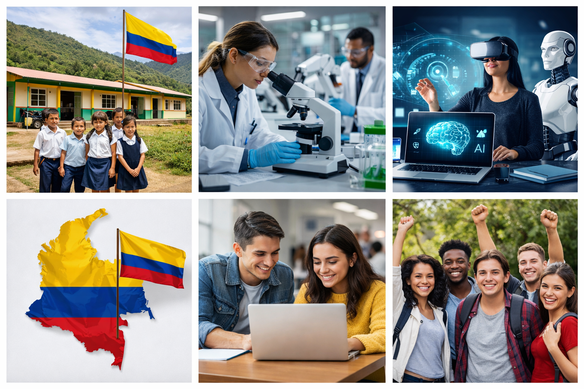
In recent years, Colombia has made important progress in education.
The government has invested a lot of money in improving schools and access to education.
According to the Ministry of Education, more than 64,000 students have benefited from new infrastructure projects, especially in rural areas.
Also, the government has invested over 567 billion pesos to improve learning and provide better opportunities for children and young people.
In addition, new programs promote environmental education and inclusion for different communities.

Slide 3
In science, Colombia is also growing.
The Ministry of Science has created programs to develop skills in young people.
For example, more than 5,800 students are learning about science, technology, and AI through special programs.
Also, there are investments in research, innovation, and international education programs.
The Minister of Science said that “this is a historic moment for science and technology in our country.”
This shows that Colombia is trying to become a more innovative country.

Slide 4
Technology has also improved a lot.
The government invested money in internet access, digital education, and innovation.
According to the Ministry of ICT, technology is reaching places where it wasn’t available before.
This helps reduce inequality, especially in rural areas.

Slide 5
In my opinion, these advances are very positive because they help young people have better opportunities.
However, there are still problems, especially in rural areas where access to education and technology is limited.
I think the government should continue investing more and also listen to communities to improve these programs.

Slide 6
In conclusion, Colombia is making progress in education, science, and technology, but there is still work to do. These areas are key for the future, and with more effort, the country can achieve better development. Thank you for watching.

